Slide 1
UNIT-V
UNIT V: - OPTIMIZATION OF PROCESSOR PERFORMANCE

Slide 2
What Is Pipelining?
Pipelining is an implementation technique whereby multiple instructions are overlapped in execution
Pipelining exploits parallelism among the instructions in a sequential instruction stream.
pipelining is the key implementation technique used to make fast CPUs.
each step in the pipeline completes a part of an instruction.

Slide 3
What Is Pipelining?
Each of these steps is called a pipe stage or a pipe segment
The stages are connected one to the next to form a pipe—instructions enter at one end, progress through the stages, and exit at the other end
The time required between moving an instruction one step down the pipeline is a processor cycle . The length of a processor cycle is determined by the time required for the slowest pipe stage

Slide 4
What Is Pipelining?
If the stages are perfectly balanced, then the time per instruction on the pipelined processor—assuming ideal conditions—is equal to
=Time per instruction on un pipelined machine
__________________________________
Number of pipe stages

Slide 5
Five stages of Pipeline
1. Instruction fetch cycle(IF):
Send the program counter (PC) to memory and fetch the current instruction from memory.
Update the PC to the next sequential PC by adding 4 (since each instruction is 4 bytes) to the PC.

Slide 6
Five stages of Pipeline
2.Instruction decode/register fetch cycle(ID):
Decode the instruction and read the registers.
Decoding is done in parallel with reading registers, which is possible because the register specifiers are at a fixed location in a RISC architecture. This technique is known as fixed-field decoding

Slide 7
Five stages of Pipeline
3. Execution/effective address cycle (EX):
Perform one of three functions depending on the instruction type.
Memory reference: The ALU adds the base register and the offset to form the effective address

Slide 8
Five stages of Pipeline
Register-Register ALU instruction: The ALU performs the operation specified by the opcode on the values read from the register file.
Register-Immediate ALU instruction: The ALU performs the operation specified by the opcode on the first value read from the register file and the sign-extended immediate

Slide 9
Five stages of Pipeline
4. Memory access (MEM):
If the instruction is a load, memory does a read using the effective address computed in the previous cycle. If it is a store, then the memory writes the data from the second register read from the register file using the effective address.
5.Write-back cycle(WB):
Register-Register ALU instruction or Load instruction: Write the result into the register file, whether it comes from the memory system (for a load) or from the ALU (for an ALU instruction).

Slide 10
Pipeline
starting a new instruction on each clock cycle
don’t try to perform two different operations with the same data path resource on the same clock cycle.
For example, a single ALU cannot be asked to compute an effective address and perform a subtract operation at the same time
Second, the register file is used in the two stages: one for reading in ID and one for writing in WB.
To handle reads and a write to the same register we perform the register write in the first half of the clock cycle and the read in the second half

Slide 11
Pipeline
we must also ensure that instructions in different stages of the pipeline do not interfere with one another.
This separation is done by introducing pipeline registers between successive stages of the pipeline, so that at the end of a clock cycle all the results from a given stage are stored into a register that is used as the input to the next stage on the next clock cycle

Slide 12
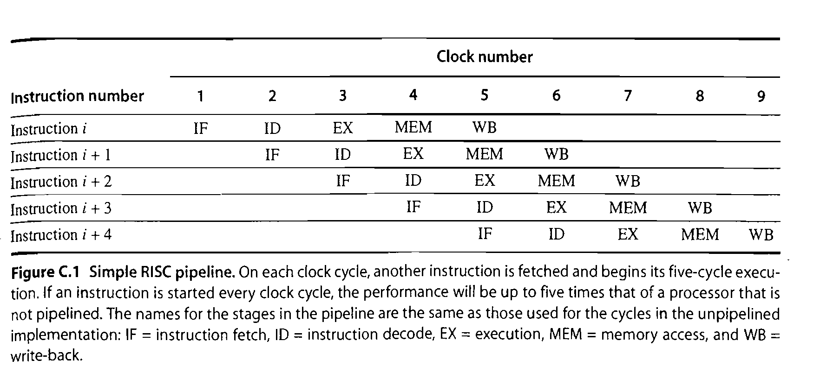

Slide 14
Throughput and speedup
Pipelining increases the CPU instruction throughput—the number of instructions completed per unit of time—but it does not reduce the execution time of an individual instruction
Pipeline overhead arises from the combination of pipeline register delay and clock skew.

Slide 15
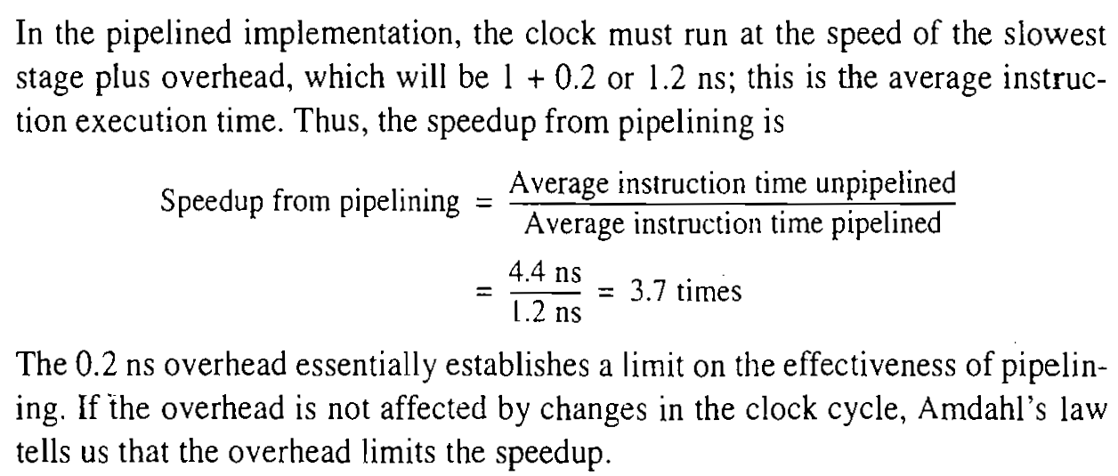

Slide 16
The Major Hurdle of Pipelining—Pipeline Hazards
There are situations, called hazards, that prevent the next instruction in the instruction stream from executing during its designated clock cycle.
Hazards reduce the performance from the ideal speedup gained by pipelining.
There are three classes of hazards:
1. Structural hazards
arise from resource conflicts when the hardware cannot support all possible combinations of instructions simultaneously in overlapped execution.

Slide 17
2. Data hazards
arise when an instruction depends on the results of a previous instruction
3.Control hazards
arise from the pipelining of branches and other instructions that change the PC.
Hazards in pipelines can make it necessary to stall the pipeline

Slide 18
Structural Hazards
If some combination of instructions cannot be accommodated because of resource conflicts, the processor is said to have a structural hazard.
When a sequence of instructions encounters this hazard, the pipeline will stall one of the instructions until the required unit is available. Such stalls will increase the CPI from its usual ideal value of 1.

Slide 19
Structural Hazards
Some pipelined processors have shared a single-memory pipeline for data and instructions. As a result, when an instruction contains a data memory reference, it will conflict with the instruction reference for a later instruction
To resolve this hazard, we stall the pipeline for 1 clock cycle when the data memory access occurs. A stall is commonly called a pipeline bubble or just bubble

Slide 21
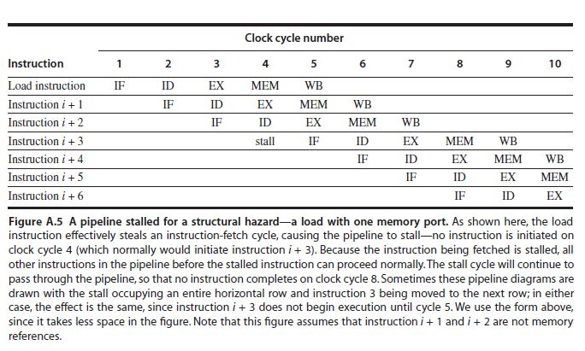
Structural Hazards

Slide 22
Data Hazards
Data hazards arise when an instruction depends on the results of a previous instruction in a way that is exposed by the overlapping of instructions in the pipeline.
Consider the pipelined execution of these instructions:
DADD R1,R2,R3
DSUB R4,R1,R5
AND R6,R1,R7
OR R8,R1,R9
XOR R10,R1,R11

Slide 23
the DADD instruction writes the value of R1 in the WB pipe stage, but the DSUB instruction reads the value during its ID stage. This problem is called a data hazard

Slide 24
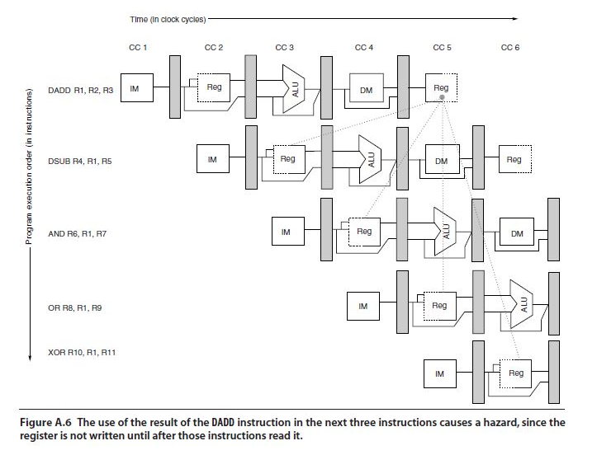

Slide 25
Minimizing Data Hazard Stalls by Forwarding
forwarding (also called bypassing and sometimes short-circuiting)

Slide 26
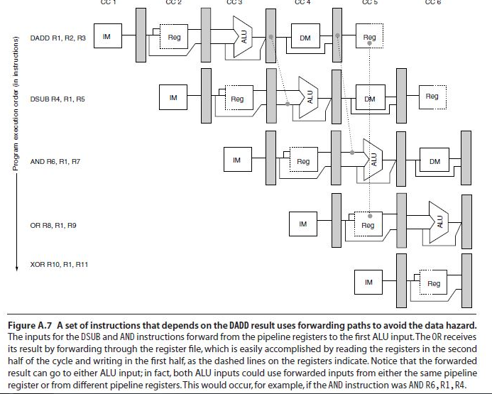

Slide 27
Data Hazards Requiring Stalls
Consider the following sequence of instructions:
LD R1,0(R2)
DSUB R4,R1,R5
AND R6,R1,R7
OR R8,R1,R9

Slide 28
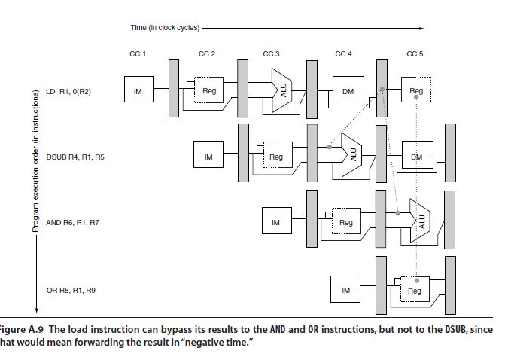

Slide 29
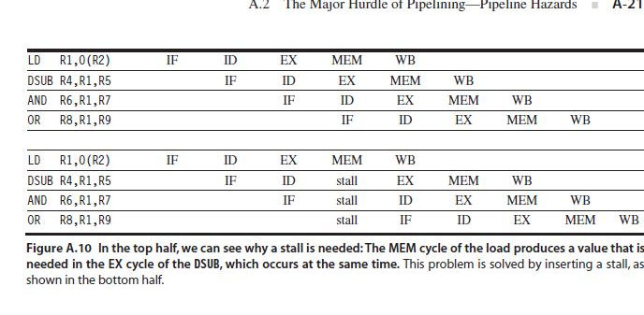

Slide 30
3.Control hazards
3.Control hazards
arise from the pipelining of branches and other instructions that change the PC.
taken branch-if a branch changes the PC to its target address
not taken-if it falls through

Slide 31
Branch Hazards
the simplest method of dealing with branches is to redo the fetch of the instruction following a branch, once we detect the branch during ID
One stall cycle for every branch will yield a performance loss of 10% to 30% depending on the branch frequency

Slide 32
Branch Hazards

Slide 33
Understanding Modern Processors
The overall design has two main parts. The Instruction Control Unit (ICU) is responsible for reading a sequence of instructions from memory and generating from these a set of primitive operations to perform on program data.
The Execution Unit (EU) then executes these operations.
The ICU reads the instructions from an instruction cache—a special, high-speed memory containing the
most recently accessed instructions.

Slide 34
Understanding Modern Processors
The ICU fetches well ahead of the currently executing instructions, so that it has enough time to decode these and send operations down to the EU.
One problem, however, is that when a program hits a branch, there are two possible directions the program might go.
The branch can be taken, with control passing to the branch target.
Alternatively, the branch can be not taken, with control passing to the next instruction in the instruction sequence.

Slide 35
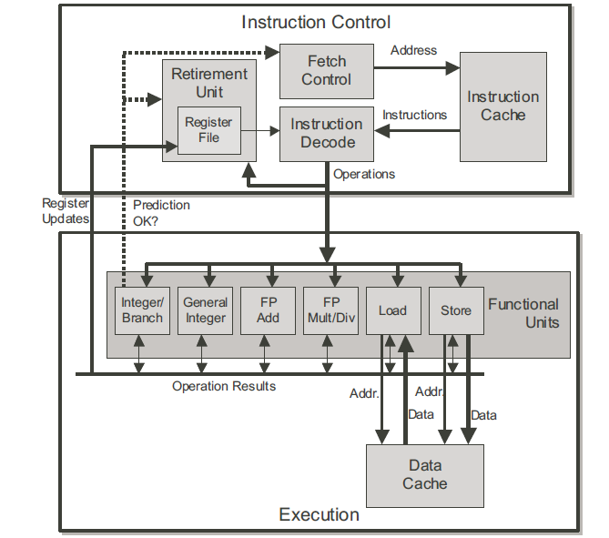
Understanding Modern Processors

Slide 36
Understanding Modern Processors
Modern processors employ a technique known as branch prediction, where they guess whether or not a branch will be taken, and they also predict the target address for the branch.
Using a technique known as speculative execution, the processor begins fetching and decoding instructions at where it predicts the branch will go, and even begins executing these operations before it has been determined whether or not the branch prediction was correct

Slide 37
Understanding Modern Processors
If it later determines that the branch was predicted incorrectly, it resets the state to that at the branch point and begins fetching and executing instructions in the other direction
The block labeled Fetch Control incorporates branch prediction to perform the task of determining which instructions to fetch.
The Instruction Decoding logic takes the actual program instructions and converts them into a set of primitive operations.

Slide 38
Understanding Modern Processors
Each of these operations performs some simple computational task such as adding two numbers, reading data from memory, or writing data to memory.
For machines with complex instructions, an instruction can be decoded into a variable number of operations

Slide 39
Understanding Modern Processors
In this machine, decoding the instruction
addl %eax,%edx
yields a single addition operation, whereas decoding the instruction
addl %eax,4(%edx)
yields three operations: one to load a value from memory into the processor, one to add the loaded value to the value in register %eax, and one to store the result back to memory.
This decoding splits instructions to allow a division of labor among a set of dedicated hardware units. These units can then execute the different parts of multiple instructions in parallel.

Slide 40
Understanding Modern Processors
The EU receives operations from the instruction fetch unit.
Typically, it can receive a number of them on each clock cycle. These operations are dispatched to a set of functional units that perform the actual operations.
The units in the figure are as follows:
Integer/Branch: Performs simple integer operations (add, test, compare, logical).
General Integer: Can handle all integer operations, including multiplication and division.
Floating-Point Add: Handles simple floating-point operations (addition, format conversion).

Slide 41
Understanding Modern Processors
Floating-Point Multiplication/Division: Handles floating-point multiplication and division. More complex floating-point instructions, such transcendental functions, are converted into sequences of operations.
Load: Handles operations that read data from the memory into the processor. The functional unit has an adder to perform address computations.
Store: Handles operations that write data from the processor to the memory. The functional unit has an adder to perform address computations.

Slide 42
Understanding Modern Processors
The load and store units access memory via a data cache, a high-speed memory containing the most recently accessed data values
Within the ICU, the Retirement Unit keeps track of the ongoing processing and makes sure that it obeys the sequential semantics of the machine-level program.
A Register File, containing the integer and floating-point registers, as part of the Retirement Unit, because this unit controls the updating of these registers.

Slide 43
Understanding Modern Processors
As an instruction is decoded, information about it is placed in a first-in, first-out queue. This information remains in the queue until one of two outcomes occurs.
First, once the operations for the instruction have completed and any branch points leading to this instruction are confirmed as having been correctly predicted, the instruction can be retired, with any updates to the program registers being made.
If some branch point leading to this instruction was mispredicted, on the other hand, the instruction will be flushed, discarding any results that may have been computed. By this means, mispredictions will not alter the program state.

Slide 44
Understanding Modern Processors
The most common mechanism for controlling the communication of operands among the execution units is called register renaming.
Execution units passes the values directly from one operation to another, rather than being written to and read from the register file.

Slide 45
Translating Instructions into Operations
We consider the cases of integer data with both multiplication and addition as the combining operations.
The compiled code for this loop with multiplication consists of four instructions.
In this code, register %eax holds the pointer data, %edx holds i, %ecx holds x, and %esi holdslength.

Slide 46
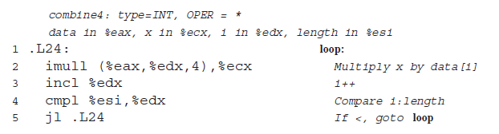

Slide 47
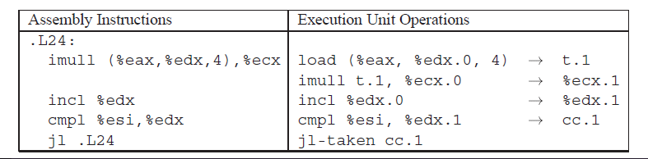
On the first iteration, with i equal to 0, our hypothetical machine would issue the following sequence of operations:

Slide 48

Thus, the value in register %ecx is identified by the label %ecx.0 at the beginning of the loop,and by %ecx.1 after it has been updated.
the label t.1 to denote the value read by the load operation and passed to the imull operation, and we explicitly show the destination of the operation.

Slide 49
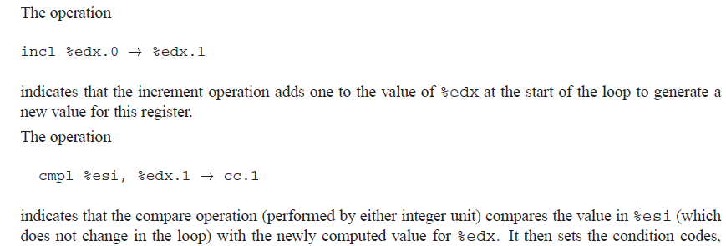

Slide 50

checks whether the newly computed values for the condition codes (cc.1) indicate this was the correct choice.
If not, then it signals the ICU to begin fetching instructions at the instruction following the jl.
To simplify the notation, we omit any information about the possible jump destinations.

Slide 51
Processing of Operations by the Execution
this case, integer multiplication imull requires four cycles, load requires three, andthe other operations require one
The chain on the left processes the data, first reading an array element from memory and then multiplying it times the accumulated product.
The chain on the right processes the loop index i, first incrementing it and then comparing it to length.
The jump operation checks the result of this comparison to make sure the branch was correctly predicted.
If the branch was correctly predicted, no other processing is required.
The branch was incorrectly predicted, then the branch function unit will signal the instruction fetch control unit, and this unit will take corrective action

Slide 52
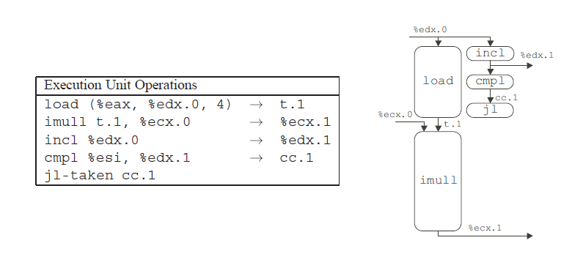
Operations for First Iteration of Inner Loop of combine4 for integer multiplication.

Slide 53
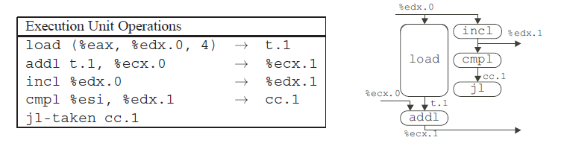
Operations for First Iteration of Inner Loop of combine4 for Integer Addition

Slide 54
Scheduling of Operations with Unlimited Resources
Imagine first a processor with an unlimited number of functional units and with perfect branch prediction. Each operation could then begin as soon as its data operands were available.
The performance of such a processor would be limited only by the latencies and throughputs of the functional units, and the data dependencies in the program

Slide 55
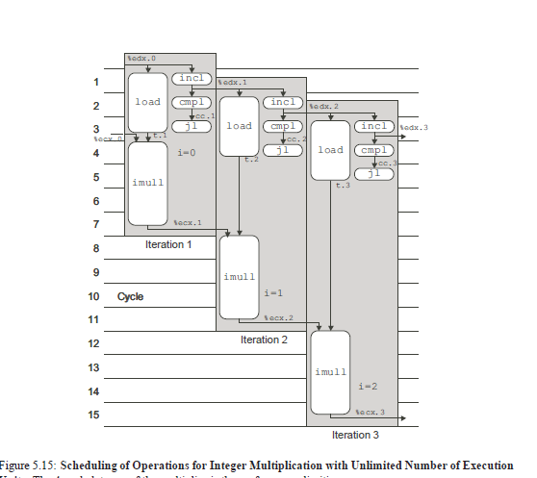
Shows the computation graph for the first three iterations of the loop

Slide 56
The arrows from the operators of one iteration to those
of another show the data dependencies between the different iterations.
Each operator is placed vertically at the highest position possible, subject to the constraint that no arrows can point upward, since this would indicate information flowing backward in time.
Thus, the load operation of one iteration can begin as soon as the incl operation of the previous iteration has generated an updated value of the loop index.
Each iteration requires at least seven cycles from start to end, but successive iterations are completed every 4
cycles. Thus, the effective processing rate is one iteration every 4 cycles, giving a CPE of 4.0

Slide 57
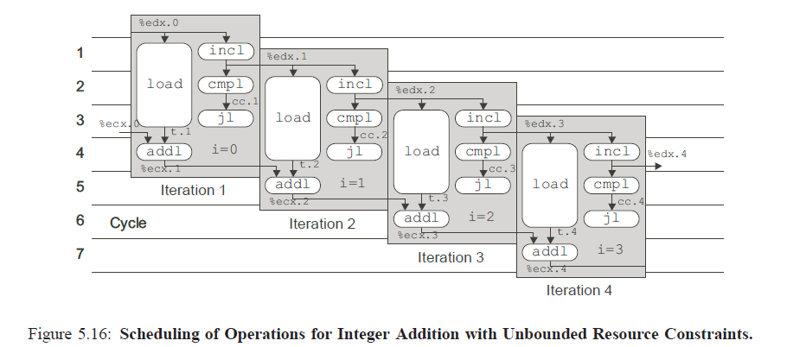
Scheduling of Operations for Integer Addition with Unbounded Resource Constraints.

Slide 58
Scheduling of Operations for Integer Addition with Unbounded Resource Constraints.
The Execution Unit would perform parts of seven operations on each clock cycle.
For example, in cycle 4 we can see that the machine is executing the addl for iteration 1;
different parts of the load operations for iterations 2, 3, and 4; the jl for iteration 2; the cmpl for iteration 3; and the incl for iteration 4.

Slide 59
Scheduling of Operations with Resource Constraints
our processor has only two units capable of performing integer and branch operations.
the general integer unit and the branch/integer unit can each begin a new operation on every clock cycle.
The multiplier latency remains the performance-limiting factor in case I
The limitation to two integer units constrains performance to a CPE of 2.0. in case II

Slide 60
three types of constraints
The data dependencies in the program force some operations to delay until their operands have been computed.
The resource constraints limit how many operations can be performed at any given time.
The degree of pipelining by the functional units

Slide 61
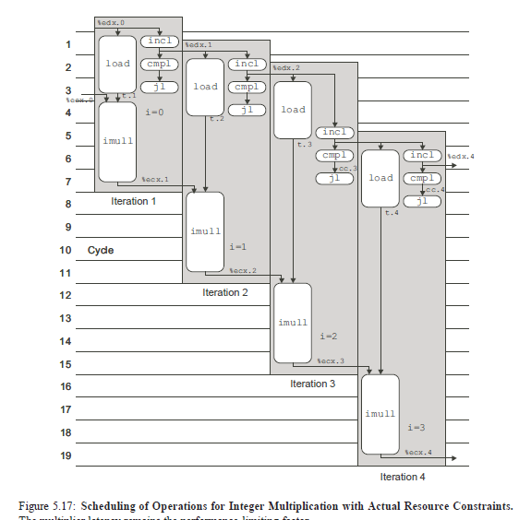

Slide 62
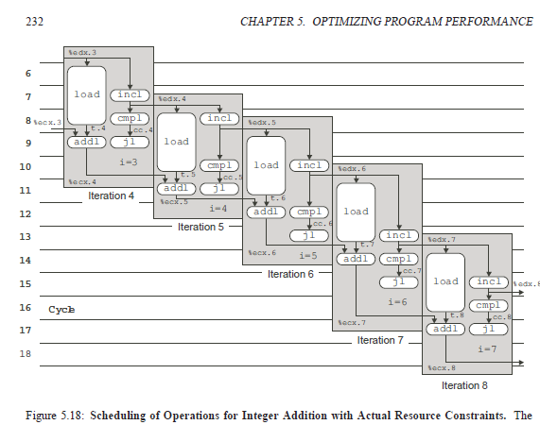

Slide 63
Reducing Loop Overhead
The performance of combine4 for integer addition is limited by the fact that each iteration contains four instructions, with only two functional units capable of performing them.
Only one of these four instructions operates on the program data.
The others are part of the loop overhead of computing the loop index and testing the loop condition.
To reduce overhead effects by performing more data operations in each iteration, via a technique known
as loop unrolling

Slide 64
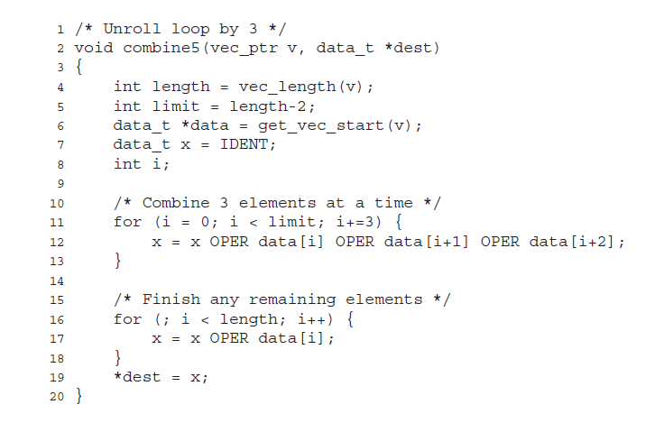

Slide 65
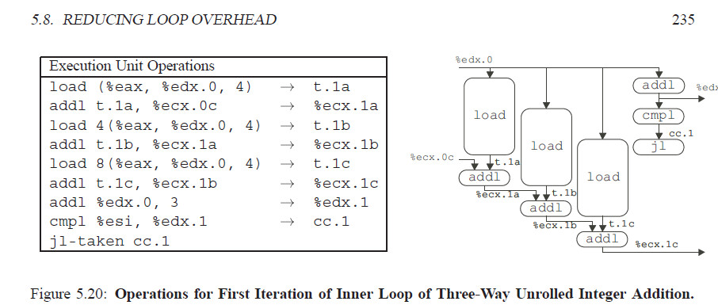

Slide 66
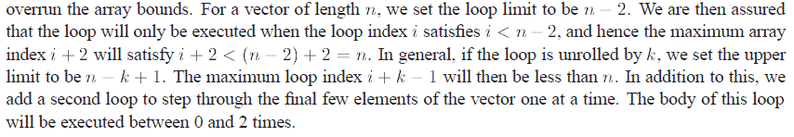

Slide 67
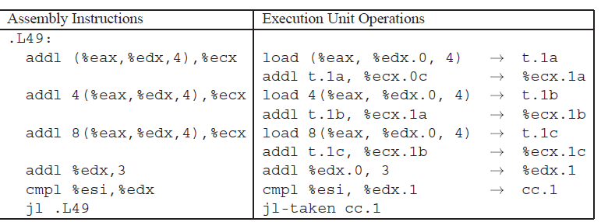

Slide 68
loop unrolling by itself will only help the performance of the code for the case of integer sum, since our other cases are limited by the latency of the functional units.
For integer sum, three way unrolling allows us to combine three elements with six integer/branch operation

Slide 69
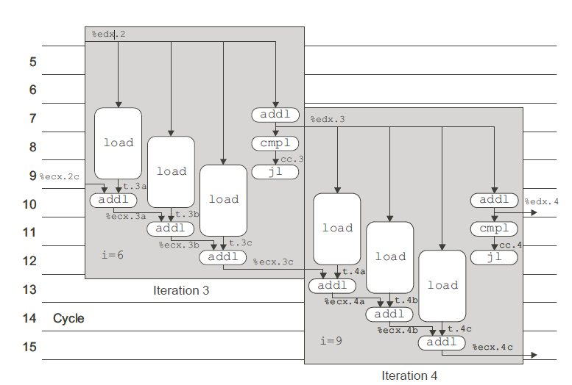
Scheduling of Operations for Three-Way Unrolled Integer Sum with Bounded Resource Constraints

Slide 70
Enhancing Parallelism
Several functional units of the processor are pipelined, meaning that they can start on a new operation before the previous one is completed.
Our code cannot take advantage of this capability, even with loop unrolling, since we are accumulating the value as a single variable x.
We cannot compute a new value of x until the preceding computation has completed.
As a result, the processor will stall, waiting to begin a new operation until the current one has completed.
Even with unbounded processor resources, the multiplier can only produce a new result every four clock cycles.
Similar limitations occur with floating-point addition (three cycles) and multiplication (five cycles).

Slide 71
Loop Splitting
Register Spilling
Limits to Parallelism

Slide 72
Loop Splitting :
For a combining operation that is associative and commutative, such as integer addition or multiplication, we can improve performance by splitting the set of combining operations into two or more parts and combining the results at the end.
For example, let Pn denote the product of elements a0; a1;:::;an1:

Slide 73

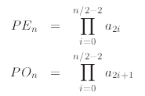

Slide 74
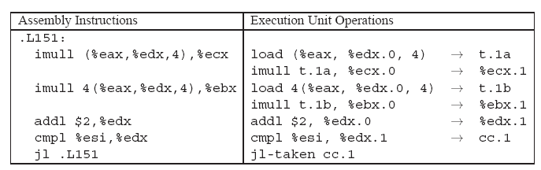
Let us consider the translation of the loop into operations for the case of integer multiplication:

Slide 75
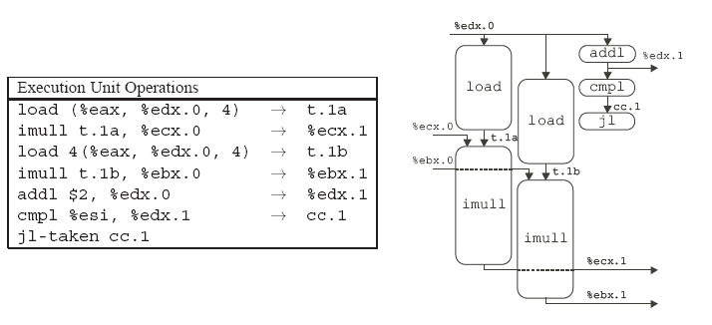

Slide 76
As this diagram illustrates, the two multiplications in the loop are independent of each other.
One has register %ecx as its source and destination (corresponding to program variable x0), while the other has register %ebx as its source and destination (corresponding to program variable x1).
The second multiplication can start just one cycle after the first.
This makes use of the pipelining capabilities of both the load unit and the integer multiplier.

Slide 77
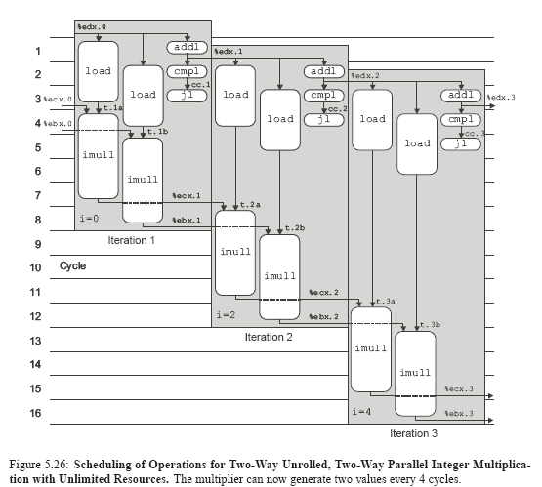

Slide 78
For each iteration, the two multiplications must wait until the results from the previous iteration
have been computed. Still, the machine can generate two results every four clock cycles, giving a theoretical
CPE of 2.0. In this figure we do not take into account the limited set of integer functional units, but this
does not prove to be a limitation for this particular procedure.

Slide 79

Comparing loop unrolling alone to loop unrolling with two-way parallelism, we obtain the following performance:

Slide 80
For integer sum, parallelism does not help, as the latency of integer addition is only one clock cycle.
For integer and floating-point product, however, we reduce the CPE by a factor of two.
We are essentially doubling the use of the functional units.
For floating-point sum, some other resource constraint is limiting our CPE to 2.0, rather than the theoretical value of 1.5.

Slide 81
We have seen earlier that two’s complement arithmetic is commutative and associative, even when overflow occurs.
Hence for an integer data type, the result computed by combine6will be identical to that computed by combine5 under all possible conditions.
Thus, an optimizing compiler could potentially convert the code shown in combine4 first to a two-way unrolled variant of combine5 by loop unrolling, and then to that of combine6 by introducing parallelism. This is referred to as iteration splitting in the optimizing compiler literature.
Many compilers do loop unrolling automatically, but relatively few do iteration splitting.

Slide 82
Register Spilling
The benefits of loop parallelism are limited by the ability to express the computation in assembly code.
In particular, the IA32 instruction set only has a small number of registers to hold the values being accumulated
If we degree of parallelism, p that exceeds number of available registers then the compiler resort to spilling, storing some of the temporary values in the stack.
Once this happens performance drops dramatically.

Slide 83
For the case of the integer data type, there are only eight total integer registers available.
Two of these (%ebp and %esp) point to regions of the stack.
With the pointer version of the code, one of the remaining six holds the pointer data, and one holds the stopping position dend.
This leaves only four integer registers for accumulating values. With the array version of the code, we require three registers to hold the loop index i, the stopping index limit, and the array address data.

Slide 84
This leaves only three registers for accumulating values.
For the floating-point data type, we need two of eight registers to hold intermediate values, leaving six for accumulating values.
Thus, we could have a maximum parallelism of six before register spilling occurs.

Slide 85
This limitation to eight integer and eight floating-point registers is an unfortunate artifact of the IA32 instruction set.
The renaming scheme described previously eliminates the direct correspondence between register names and the actual location of the register data.
In a modern processor, register names serve simply to identify the program values being passed between the functional units.
IA32 provides only a small number of such identifiers, constraining the amount of parallelism that can be expressed in programs.

Slide 86
Limits to Parallelism
the main performance limitations are due to the capabilities of the functional units.
the integer multiplier and the floating-point adder can only initiate a new operation every clock cycle.
This, plus a similar limitation on the load unit limits these cases to a CPE of 1.0.
The floating-point multiplier can only initiate a new operation every two clock cycles.
This limits this case to a CPE of 2.0. Integer sum is limited to a CPE of 1.0, due to the limitations of the load unit.

